Slide 1
Project Presentation.
Faculty of Computing information Management.
Course: Bachelor of Business Information Technology
Name: Abraham Mutinda.
Registration Number: 19/02862
Email: 1902842@students.kcau.ac.ke
Supervisor: Collins Ondiek.
Title: Alliance Homes Management System.

Slide 2
Introduction
Welcome to my final project presentation on Alliance homes Management Systems. I will share with you the key features and benefits of my Alliance homes Management System, which is designed to streamline the rental process and make it easier for property owners and managers to manage their properties.
I will then discuss the key features of the system, including its user interface and reporting capabilities. Finally, I will discuss the benefits of using the system and how it can help property owners and managers save time and increase efficiency.

Slide 3
Background
Managing estate properties can be a complex and time-consuming task. Property owners and managers need to keep track of various details such as tenant information, lease agreements, rent payments, maintenance requests, and more. Traditional methods of managing rentals involve a lot of paperwork, phone calls, and manual processes, which can lead to errors and inefficiencies.
Alliance homes Management Systems can save property owners and managers time and money by automating many of the manual processes involved in managing rentals. They also provide real-time visibility into rental performance, enabling property owners and managers to make more informed decisions about their properties.

Slide 4
Problem statement
The problem that my Alliance homes Management System aims to solve is the inefficiencies and challenges associated with traditional methods of managing rental properties. As mentioned earlier, managing rental properties can be a complex and time-consuming task, involving a lot of paperwork, phone calls, and manual processes. These traditional methods can lead to errors and inefficiencies, which can have a negative impact on the profitability of the property.

Slide 5
Aims and Objectives
Improve communication between property owners, managers, and tenants: The system aims to improve communication between property owners, managers, and tenants by providing a centralized platform for all communication related to rentals.
Automate rental management tasks: The system aims to automate many of the manual processes involved in managing rentals, such as rent collection, lease management, maintenance requests, and more.
Simplify reporting and analysis: The system aims to simplify reporting and analysis by providing customizable reports and dashboards that provide insights into rental performance.

Slide 6
Literature review
Homes Management Systems have become increasingly popular in recent years as property owners and managers seek to streamline their operations and improve efficiency. Several studies have explored the benefits of Homes Management Systems, as well as the challenges associated with their implementation.
One study by Gohari et al. (2020) found that Rentals Management Systems can improve efficiency, productivity, and profitability for property owners and managers. The study highlighted the importance of automating manual processes, such as rent collection and maintenance requests, as well as the importance of real-time visibility into rental performance.
Another study by Weerawarana and Alahakoon (2020) examined the challenges associated with implementing Rentals Management Systems. The study found that one of the main challenges is resistance to change from property owners and managers, who may be accustomed to manual processes.

Slide 7
Significance of study
Understanding the benefits of Rentals Management Systems: The review highlights that Rentals Management Systems can improve efficiency, productivity, and profitability for property owners and managers. It also emphasizes the importance of automating manual processes, providing real-time visibility into rental performance, and improving communication between property owners, managers, and tenants.
Identifying the challenges associated with implementing Rentals Management Systems: The review identifies the challenges associated with implementing Rentals Management Systems, such as resistance to change, the need for user training and support, and the need for robust security features and compliance with relevant data protection regulations.
Identifying the commercial Rentals Management Systems available in the market: The review provides examples of commercial Rentals Management Systems, such as Rent Manager and AppFolio, and their features. This information can be useful for property owners and managers who are considering implementing a Rentals Management System.
Providing a basis for further research: The review highlights the need for further research on Rentals Management Systems, such as the use of Rapid Application Development methodology, and the impact of Rentals Management Systems on tenant satisfaction and retention

Slide 8
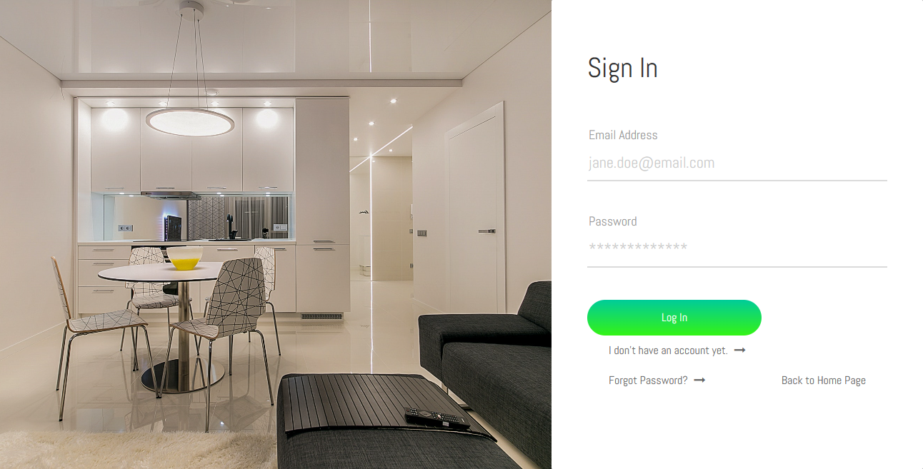
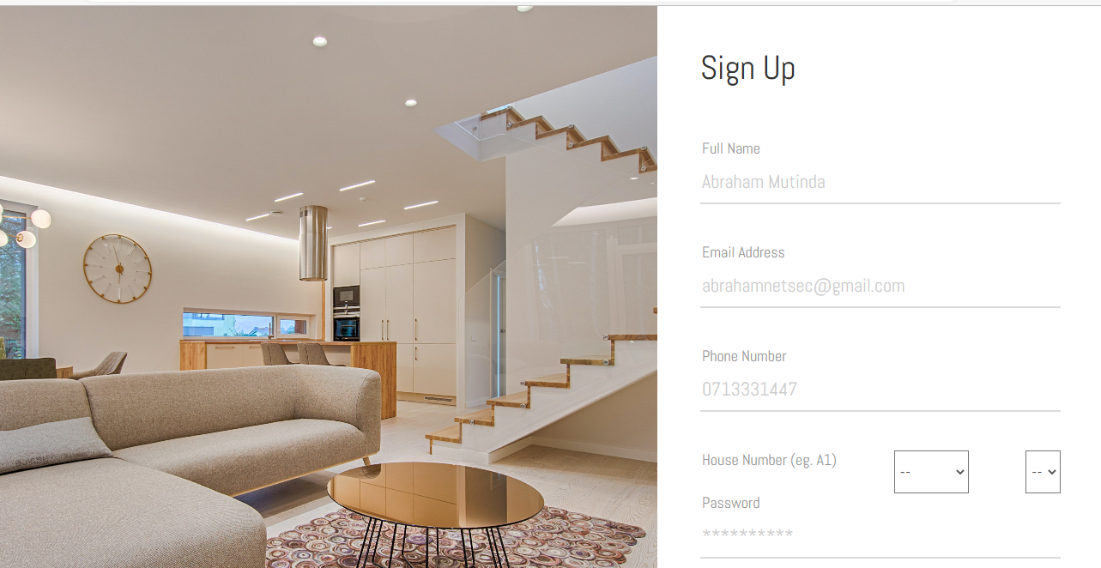
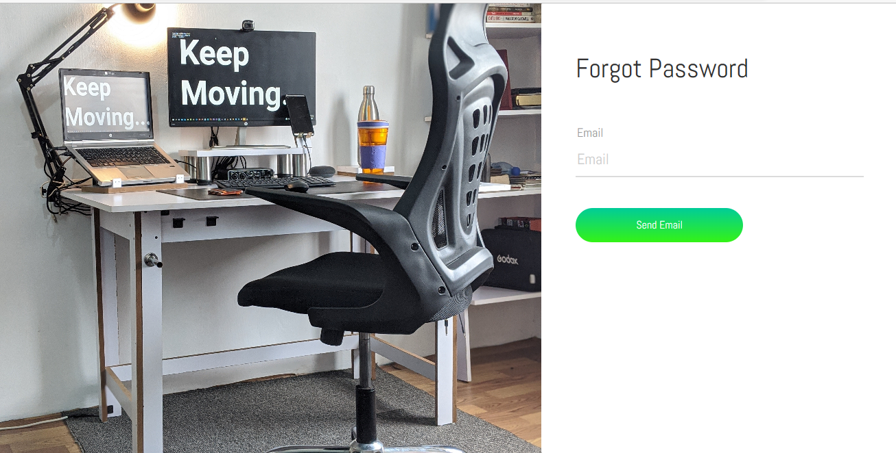
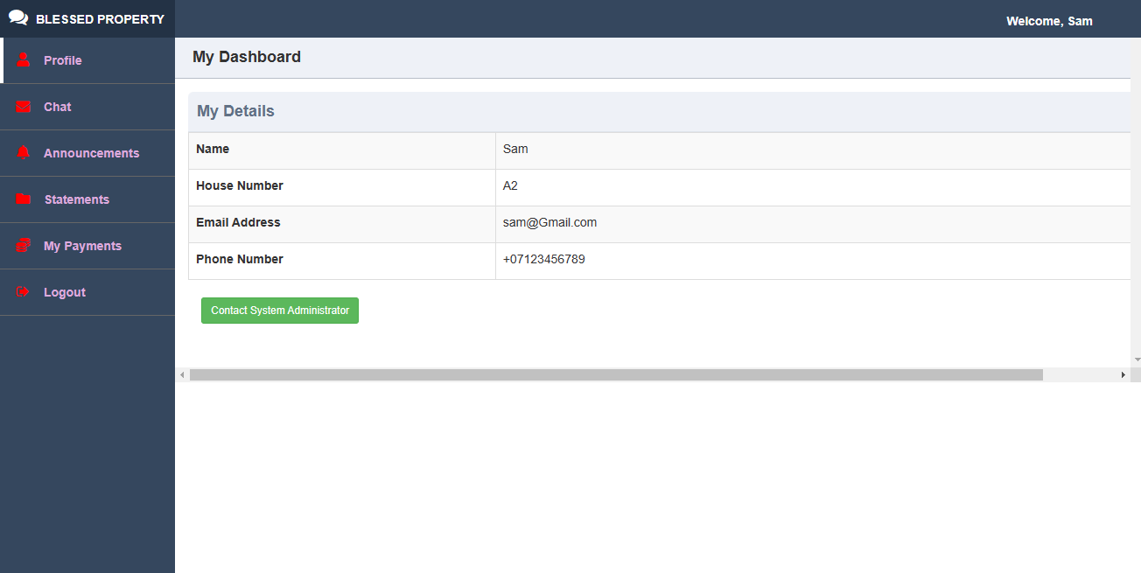
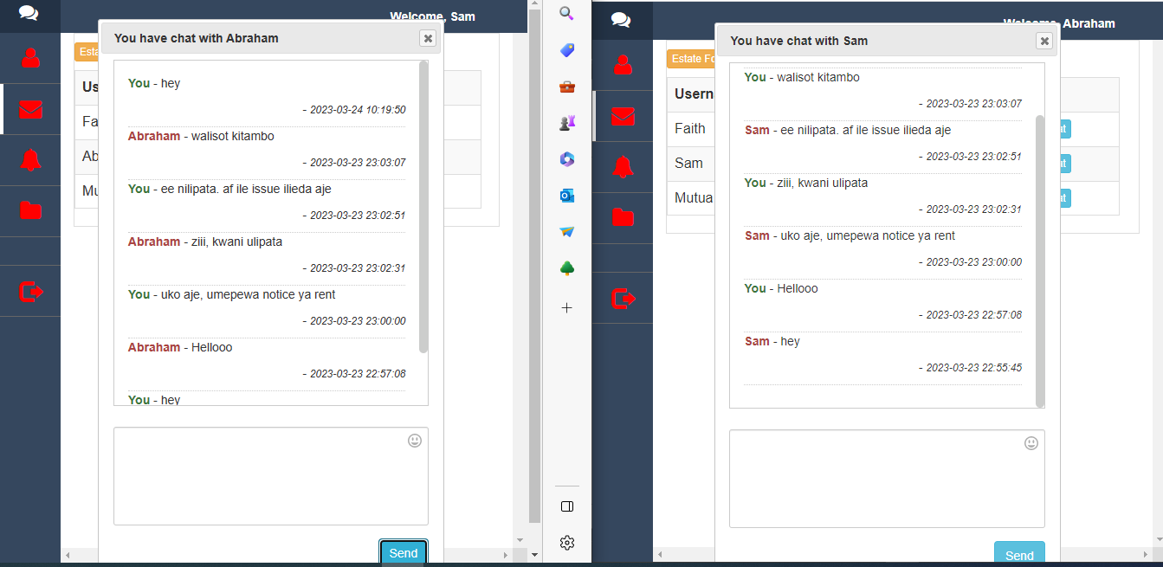
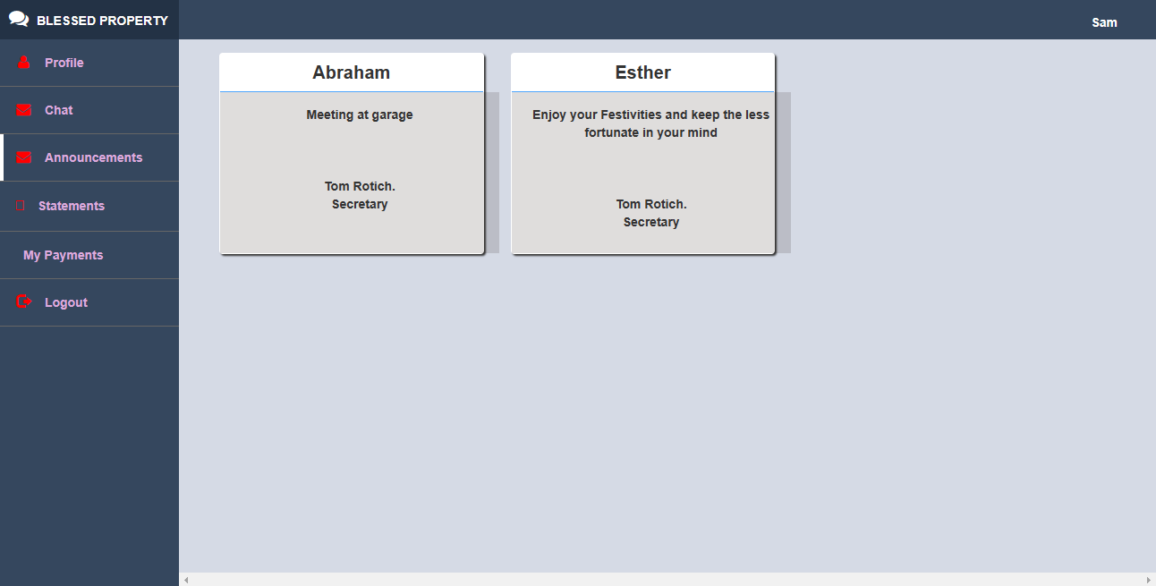
Screenshots of the system.

Slide 9
Project Schedule
Task | Description | Task no of hours | Subtask no of hours | Planned start date | Actual start date | Planned completion date | Actual completion date | Delivery
1 | Ideation | 72 hrs. |  | 27/9/22 | 29/9/22 | 2/10/22 | 3/10/22 | 4/10/22
2 | Proposal | 10 min |  | 5/10/22 | 5/10/22 | 5/10/22 | 5/10/22 | 5/10/22
3 | SRS | 2 days |  | 5/10/22 | 5/10/22 | 7/10/22 | 7/10/22 | 7/10/22
4 | Desing | 4 months | 1 month | 8/10/22 | 8/10/22 | 2/2/23 | 1/3/2023 | 24/3/2023
5 | Test | 1 week |  | 3/2/23 | 3/2/23 | 10/2/23 | 3/3/2023 | 23/3/2023
6 | Implementation | 72 hrs. |  | 11/2/22 | 11/2/23 | 14/2/23 | 10/3/2023 | 20/3/2023
7 | Maintenance plan | 48 hrs. |  | 15/2/23 | 15/2/23 | 17/2/23 | 20/3/2023 | 22/3/2023
8 | User manual | 48 hrs. |  | 20/2/23 | 20/2/23 | 22/2/23 | 21/3/2023 | 24/3/2023
9 | Final Report | 72 hrs. |  | 22/2/23 | 22/2/23 | 25/2/23 | 20/3/2023 | 24/3/2023

Slide 10
References
Gohari, M., Li, Y., Li, X., & Tan, K. C. (2020). A review of rentals management systems: Benefits, challenges, and future directions. Sustainable Cities and Society, 62, 102390.
Weerawarana, A., & Alahakoon, D. (2020). Challenges of implementing a cloud-based rentals management system for small and medium-sized enterprises. In Proceedings of the 2020 15th International Conference on Computer Science & Education (ICCSE) (pp. 224-227). IEEE.
Rent Manager. (n.d.). About Rent Manager. Retrieved March 24, 2023, from https://www.rentmanager.com/about-rent-manager/
AppFolio. (n.d.). AppFolio Property Manager. Retrieved March 24, 2023, from https://www.appfolio.com/property-management-software

